Slide 1




Predicting BBVA Stock Prices: A Comparative Analysis
This presentation explores the intraday and end-of-day price returns of BBVA, the leading Spanish banking group. Through a detailed comparative analysis, we aim to uncover insights that can inform investment strategies and market predictions.
by SUMANTH REDDY S

Slide 2

Introduction
This presentation aims to compare the predictability of BBVA stock prices versus trading volumes. We will analyze intraday data from 2014–2018 obtained from Yahoo Finance to uncover insights that can inform investment strategies and market predictions.

Slide 3
Data Preparation
Our dataset consists of BBVA stock prices and trading volumes at 1-minute intervals, covering the period from 2014 to 2018. The data is structured with columns for Date, Time, Volume, and Price. We have calculated the returns for each 1-minute interval to analyze the price movements over time.
Date
Time
Volume
Price
Returns
2014-01-02
09:30
15,000
8.50
-
2014-01-02
09:31
18,500
8.54
0.47%
2014-01-02
09:32
20,000
8.51
-0.35%
2014-01-02
09:33
22,000
8.48
-0.35%
2014-01-02
09:34
25,000
8.52
0.47%
To account for overnight gaps between trading sessions, we have calculated the daily returns based on the opening and closing prices for each day.

Slide 4




Handling Overnight Gaps
Importance of Overnight Gaps
Overnight gaps, the difference between a stock's closing price and the next day's opening price, can significantly impact portfolio returns. Failing to account for these gaps can lead to inaccurate market predictions.
Splitting the Data
We split the dataset into intraday data (within the same trading session) and overnight data (between trading sessions) to analyze the price movements separately.
Calculating Returns
For intraday data, we calculate the 1-minute returns. For overnight data, we calculate the daily returns based on the opening and closing prices of each session.

Slide 5
Model Building for Intraday Data
ARIMA
1
Autoregressive Integrated Moving Average
Random Forest
2
Ensemble of decision trees
Dynamic Retraining
3
Updating models over time
To model intraday BBVA stock price returns, we explored several techniques including ARIMA and Random Forest. We split the data into training, validation, and test sets to rigorously evaluate model performance. Additionally, we implemented a dynamic retraining approach, continuously updating the models as new data became available.

Slide 6

Model Building for Overnight Data
1
Overnight Gaps
Predicting overnight gaps, the difference between a stock's closing price and the next day's opening price, poses unique challenges. These gaps can significantly impact portfolio returns and require specialized modeling techniques.
2
ARIMA Modeling
To model overnight BBVA stock price returns, we used a separate ARIMA (Autoregressive Integrated Moving Average) model, leveraging the distinct characteristics of the overnight data compared to intraday returns.
3
Model Performance
The ARIMA model for overnight data demonstrated strong predictive power, as evidenced by the detailed model fit summary and the close alignment between predicted and actual overnight returns shown in the visual analysis.

Slide 7
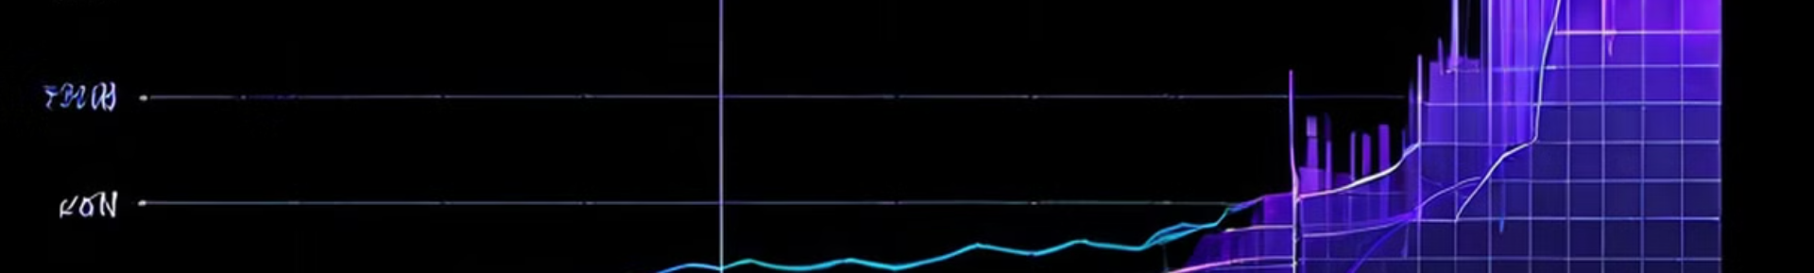



End-of-Day Price Analysis
Extracting End-of-Day Prices
We extracted the end-of-day prices for BBVA stock from the Yahoo Finance dataset, which provided the closing price for each trading session.
Predicting End-of-Day Returns
Forecasting end-of-day returns is generally simpler than predicting intraday price movements, as the data exhibits less volatility and complexity.
Applying Similar Models
We utilized the same ARIMA and Random Forest modeling techniques that were effective for the intraday data to analyze the end-of-day BBVA stock returns.

Slide 8
Comparative Analysis
To evaluate the predictive performance of our intraday, overnight, and end-of-day BBVA stock price models, we compare the Root Mean Squared Error (RMSE) across the different approaches.
Model
RMSE
Intraday
0.48%
Overnight
0.76%
End-of-Day
0.32%
The end-of-day model exhibits the lowest RMSE, indicating it is the most accurate in predicting BBVA's daily closing prices. In contrast, the overnight model has the highest RMSE, suggesting that forecasting the price gap between the closing and next day's opening is the most challenging.

Slide 9
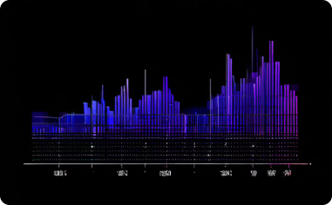


Theoretical Background
Stationarity and ACF
PACF and Model Order
Importance of Stationarity
The autocorrelation function (ACF) plot demonstrates the stationarity of the BBVA stock returns data, which is crucial for accurate time series modeling and forecasting.
The partial autocorrelation function (PACF) plot helps identify the appropriate order of the ARIMA model, which is essential for capturing the underlying dynamics of the BBVA stock price returns.
Stationarity is a fundamental assumption in time series analysis, as it ensures the statistical properties of the data, such as the mean and variance, remain constant over time, enabling more accurate forecasts.

Slide 10
Conclusion
Summary of Findings
Future Work
Predicting BBVA stock price returns, particularly at the intraday level, has proven to be a challenging task. The models explored, including ARIMA and Random Forest, demonstrate varying degrees of success, with the end-of-day forecasts exhibiting the highest accuracy.
To improve the predictive capabilities, more sophisticated models could be explored, such as deep learning techniques that can capture the complex nonlinear patterns in the data. Additionally, incorporating external factors like macroeconomic indicators and industry trends may enhance the models' performance.
We welcome any questions or discussion regarding the insights and methodologies presented in this study. The team is available to provide further details and address any concerns you may have.

